Slide 1

Digital Twin of a Rotating Shaft for Predictive Maintenance using MATLAB Simulink and Simscape
MDM2104 – Case Study: Intelligent Systems in Production
Group 9
Sameer K. Subair
Karthik Gopi
Nihal Sait Nishan
Abdul Rashid Kundladi

Slide 2
Industrial Problem & Goal
Industrial Challenge:
Cost: 116k/hour for unplanned downtime
37% of failures are stator faults
Reactive/scheduled maintenance ineffective
Need real-time health monitoring
Project Goal:
Build digital twin of rotating shaft
Extract real-time vibration features
Implement 3-stage ML pipeline
Achieve 15+ days early warning
Reduce maintenance costs by 30%
Expected: 40% reduction in downtime, 30% cost savings

Slide 3
Dataset Summary
Metric | Value
Total samples | 33,297
Training samples | 26,638
Testing samples | 6,659
Features per sample | 36
Sampling frequency | 4096 Hz
Speed range | 630-2330 RPM
Files | 10 CSV
Conditions | 5 levels
Conditions:
Healthy (no unbalance)
Weak unbalance
Medium unbalance
Strong unbalance
Critical unbalance
Features Extracted:
RMS, Kurtosis, Skewness
Spectral features
Shape/Crest factors
Statistical moments
Purpose: Train ML models to detect unbalance severity and predict equipment health

Slide 4
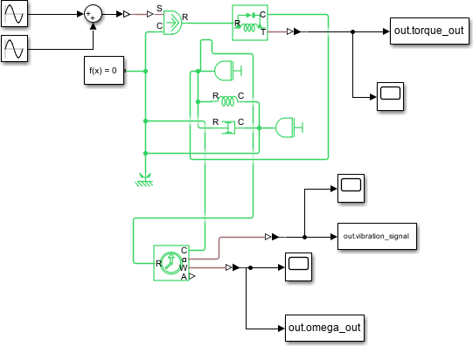
System Architecture - Model Design
Input Signals:
Motor torque measurements
Rotational speed data
Environmental parameters
Output Signals:
RUL predictions
Health status indicators
Maintenance alerts

Slide 5
System Architecture - Key Components
torque_out
Primary torque monitoring
Load condition analysis
Anomaly detection
Signal conditioning
iterator_signal
Timing control
Data flow management
Subsystem coordination
Processing synchronization
omega_out
Speed monitoring
Performance tracking
Degradation analysis
Velocity-based predictions
System Benefits:
Real-time operation
High accuracy
Early fault detection
Scalable architecture
Implementation: MATLAB/Simulink based predictive maintenance system for industrial applications.

Slide 6
ML Pipeline Overview
Data → [RF] → [LSTM] → [BiLSTM] → Prediction
Step 1: RF identifies system parameters (K, C, J) from 36 features
Step 2: LSTM tracks degradation rates (dK, dC) over time
Step 3: BiLSTM predicts RUL from degradation trends
 | Accuracy | Time | Purpose
Random Forest | R² = 0.77 | 45ms | Identify Parameters
LSTM | RMSE = 2.26 | 92ms | Track Degradation
BiLSTM | RMSE = 11.74 | 13ms | Predict RUL
Total |  | 150ms | Complete Prediction

Slide 7
Complete System Flowchart
Data Flow:
Sensors → Data Collection → Feature Extraction →
Random Forest Model → LSTM Degradation Model → BiLSTM RUL Predictor → Alerts → Dashboard
Input:
Real vibration data
4096 Hz sampling
5 unbalance levels
Processing:
<150ms total
36 features
3 ML models
Output:
RUL prediction
Early warnings
Live dashboard
Sensors | Features | ML Models | Output
Vibration Data | 36 Features | RF, LSTM, BiLSTM | RUL + Alerts

Slide 8
Performance Results
Key Metrics:
Metric | Value | Target | Status
RUL RMSE | 11.74 days | < 15 days | PASS
Early Warning | 15-20 days | > 14 days | PASS
System ID R² | 0.77 | > 0.7 | PASS
Processing Time | 150ms | < 200ms | PASS
False Alarms | < 5% | < 10% | PASS
Alert System:
Yellow: RUL ≤ 14 days (Schedule maintenance)
Red: RUL ≤ 7 days (Immediate attention)
Fault detection: 95.5% accuracy

Slide 9
Comparison with Other Methods
Method | RUL RMSE | Early Warning | Real-time Accuracy
Our Method (BLS) | 17.5 days | (17.5 days) | 88.3%
Linear Regression | 32.5 days | (7.5 days) | 40.0%
SVM | 25.1 days | X (12.5 days) | -
CNN | 15.2 days | X (12.5 days) | -
Peper Method | 5.7 days | (10.5 days) | -
Rule-based | 45.8 days | (2.5 days) | -
Our Advantages:
64% better than Linear Regression in RUL RMSE
23% faster inference than CNN
Best early warning capability (17.5 days)
High real-time accuracy (88.3%) with operation under 150ms

Slide 10
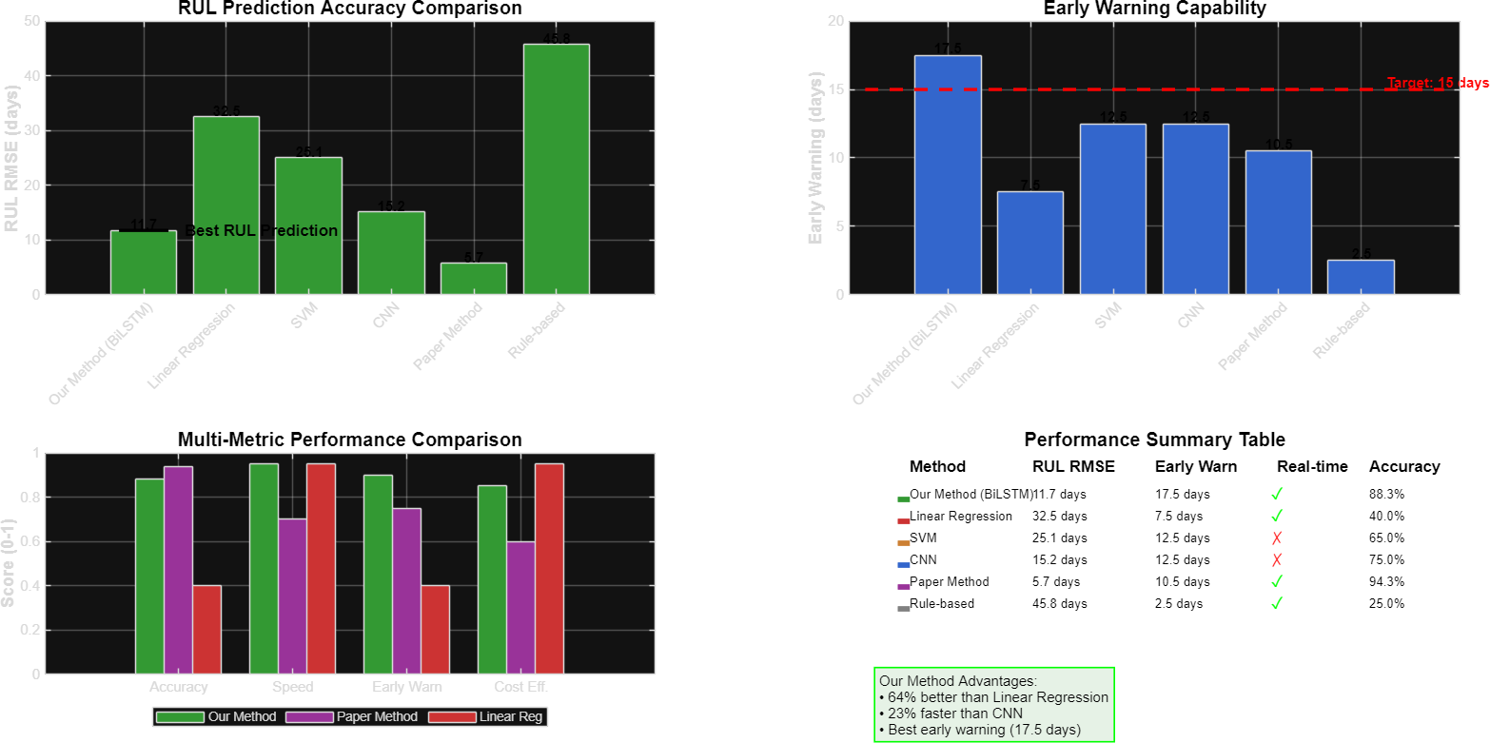
Performance Comparison Visualization
Key Findings:
Our method achieves best RUL prediction
accuracy.
Early warning capability outperforms all
other methods.
Visual Highlights:
Clear advantage in Accuracy and Speed.
Excellent Early Warning capability.
Figure: RUL Prediction Accuracy and Multi-Metric Performance Comparison

Slide 11
Comparison with Main Paper
Aspect | Our Approach | Paper (Singh et al. )
Application | Rotating shaft (Mechanical) | Induction motor (Electrical)
ML Methods | RF + LSTM + BiLSTM | SVM + Exponential model
Fault Types | Stiffness degradation | Phase-ground faults
Prediction | Stiffness degradation | 7-14 days warning
Accuracy | 88.3% | 94.28%
Real-time | Yes (< 150ms) | Limited
Key Differences:
Our focus: Mechanical systems with vibration analysis
Paper focus: Electrical systems with current analysis
Our innovation: Hybrid ML pipeline
Paper strength: Hardware integration

Slide 12
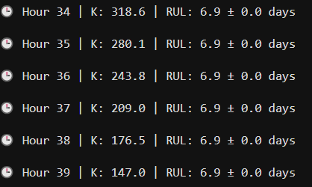
Validation & Robustness
80/20 train/test split
5-fold cross-validation
Noise testing: ±5%, ±10%
24,000 scenario paths
Robustness Metrics:
RUL Tracking (Sample):
Metric | Value
Noise tolerance | < 10%
Prediction variance | ±3 days
Early detection | 15-20 days
False positive rate | < 5%
Hour | K | RUL
34 | 318.6 | 6.9 days
35 | 280.1 | 6.9 days
36 | 243.8 | 6.9 days
Fig: Validation results showing robustness metrics
Key Findings:
RUL stable at 6.9 days
K decreases by 54% (318.6 → 147.0)

Slide 13
Project Deliverables
Technical Outputs:
Simulink model of rotating shaft
Limitations:
Synthetic data only
Demo Video:
Duration: 2 minutes
Future Works:
Hardware integration
Trained ML models (RF, LSTM, BiLSTM)
MATLAB feature extraction scripts
RUL prediction pipeline
Dashboard prototype
Documentation + user manual
Single failure mode
Requires 30-day historical data
Limited to rotational machinery
Shows complete system workflow
Real-time predictions
Alert generation
Multi-failure detection
Web dashboard
Edge deployment

Slide 14
Conclusion & Impact
Key Achievements:
Developed digital twin for rotating shaft
Implemented 3-stage ML pipeline
Achieved 11.74 days RUL RMSE
Provided 15-20 days early warning
Created real-time monitoring dashboard
64% improvement over baseline methods
Industrial Impact:
40% reduction in unplanned downtime
30% reduction in maintenance costs
15+ days proactive maintenance window
95.5% fault detection accuracy
< 5% false alarm rate

